Slide 1
CAREERS USING vce FOOD TECHNOLOGY

Slide 2
LET’S LOOK AT THE JOBS YOU CAN GET
TRADITIONAL CONCEPT
DOMESTIC BLISS
FOOD PHOTOGRAPHY HAS BECOME VERY POPULAR
FOOD SCIENCE LEADS INTO MANY PATHS

Slide 3
LET’S TAKE A CLOSER LOOK

Slide 4
Modern changes to work loads means this job has been shared out in the family. A lot of children participate in the cooking as well as the husbands or wives.
Career options when you know how to cook:
Working preparing food, limited formal qualifications required. (canteens, local takeaways, food preparation)
Qualify as a chef.
Create your own product.
Create a recipe book.
Work as a food tester/taster.
Food photography.
Meals on wheels.
Traditionally women did the majority of cooking in the home. This actually means that women needed to understand nutrition, budgeting, preparation of food, storage of food, seasonal preservation, health concerns of the family and usually the growing of food as well as the care of some livestock.

Slide 5
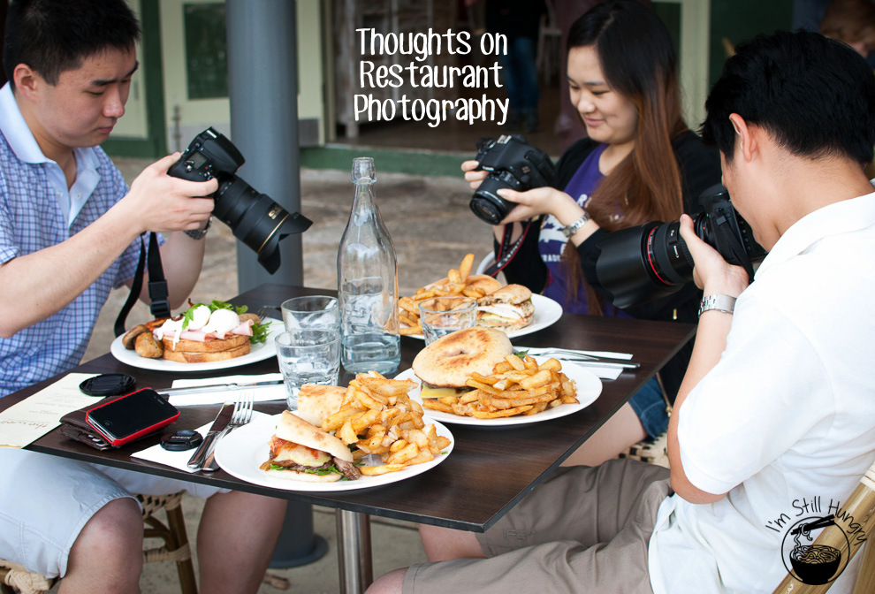
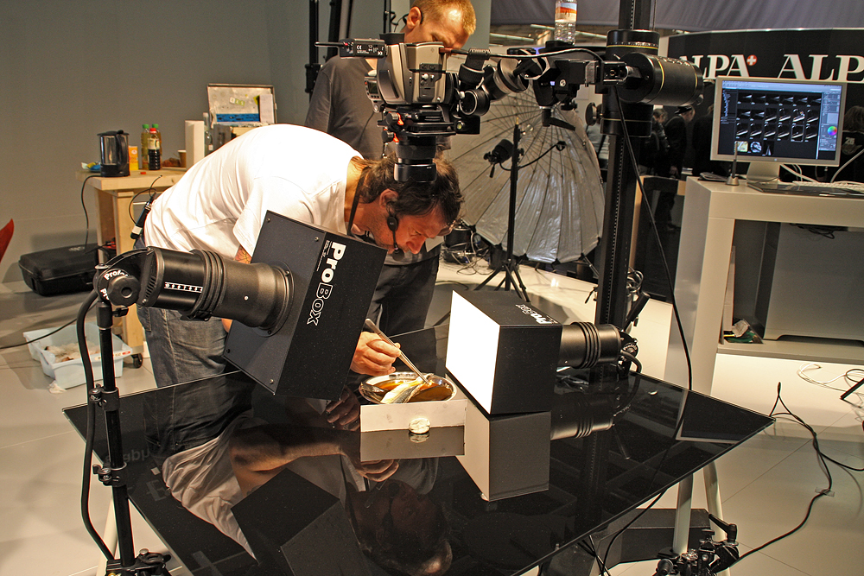
Some people earn money from social media when they post their food pictures.
This can lead to jobs as a Restaurant Critic, Product reviewer, food taster, and restaurant mystery shopper.
PROFESSIONAL FOOD PHOTOGRAPHER V’S AMATUER FOOD PHOTOGRAPHER
Food photography requires skills in knowing how food can look its best. This can lead to further food industry jobs such as a Food stylist, Movie making, Recipe books, Magazines and advertising. You can work freelance or be employed by a company.

Slide 6
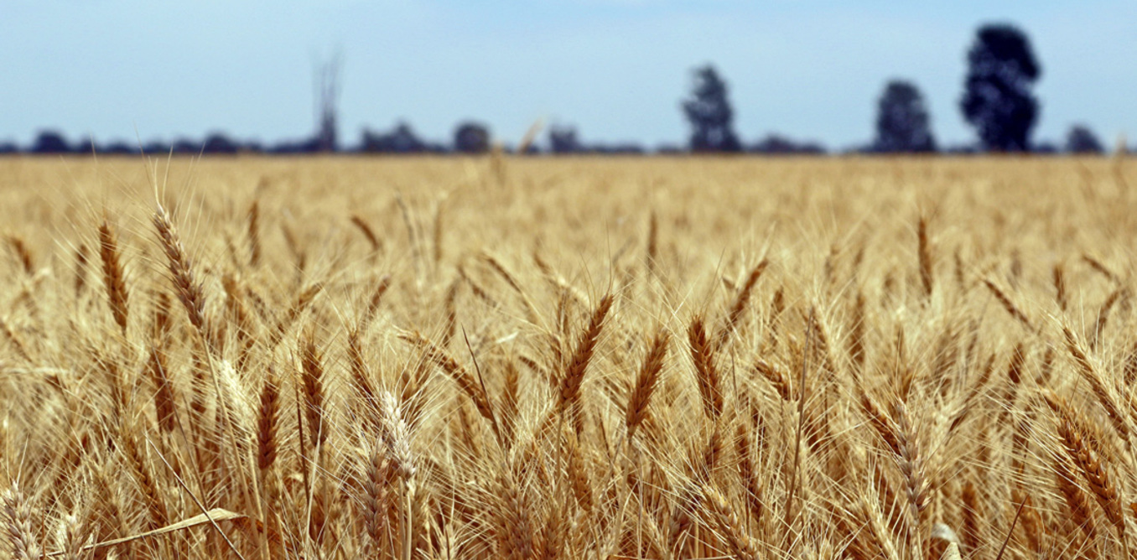
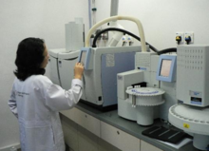
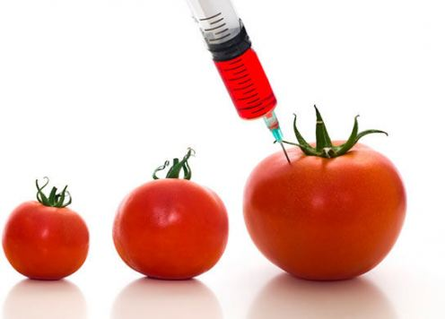
FOOD SCIENCE
Covering all aspects of food growth development, and manufacture.
When food is manufactured it has to be tested through all stages of development by trained food scientists.
GMO is the extreme version of food improvement. Scientist may change food on a DNA level to accomplish what they want.
SCIENTISTS HAVE CHANGED OUR FOOD BY USING SELECTIVE PROCESSES TO IMPROVE SIZE, CROP YIELD AND TEXTURES.

Slide 7
FOOD SCIENCE CAREERS
Food Laboratory assistant; science and food at VCE level
Nutritional educator: VCE food level, working in places such as spas, fitness centres, rehabilitation centres, and weight management centres.
Food industry professionals: developing recipes and analysing products for nutritional labelling to promoting and educating consumers about the nutritional value of specific foods.
Hospitality and catering: Tafe courses in Certificate 3/4 Hospitality. Or start with a parttime job in a food based area.
Food photographer: Skills needed degree or no degree.
Food writer: can happen with out a degree but experience of food essential.
Public Health worker: degree required. Can work in hospitals designing appropriate diets, sports diets, public announcements around food safety and programs to assist the public.
Clinical Dietitian: Degree needed. Can set up your own business or work for larger companies.
Food Educators: degree required. Teach in schools, Tafes and large companies.
Agricultural scientist: degree needed. Grows and adapts large scale food production.

