Slide 1
Goulburn Health and Wellbeing Community Supports

Slide 2


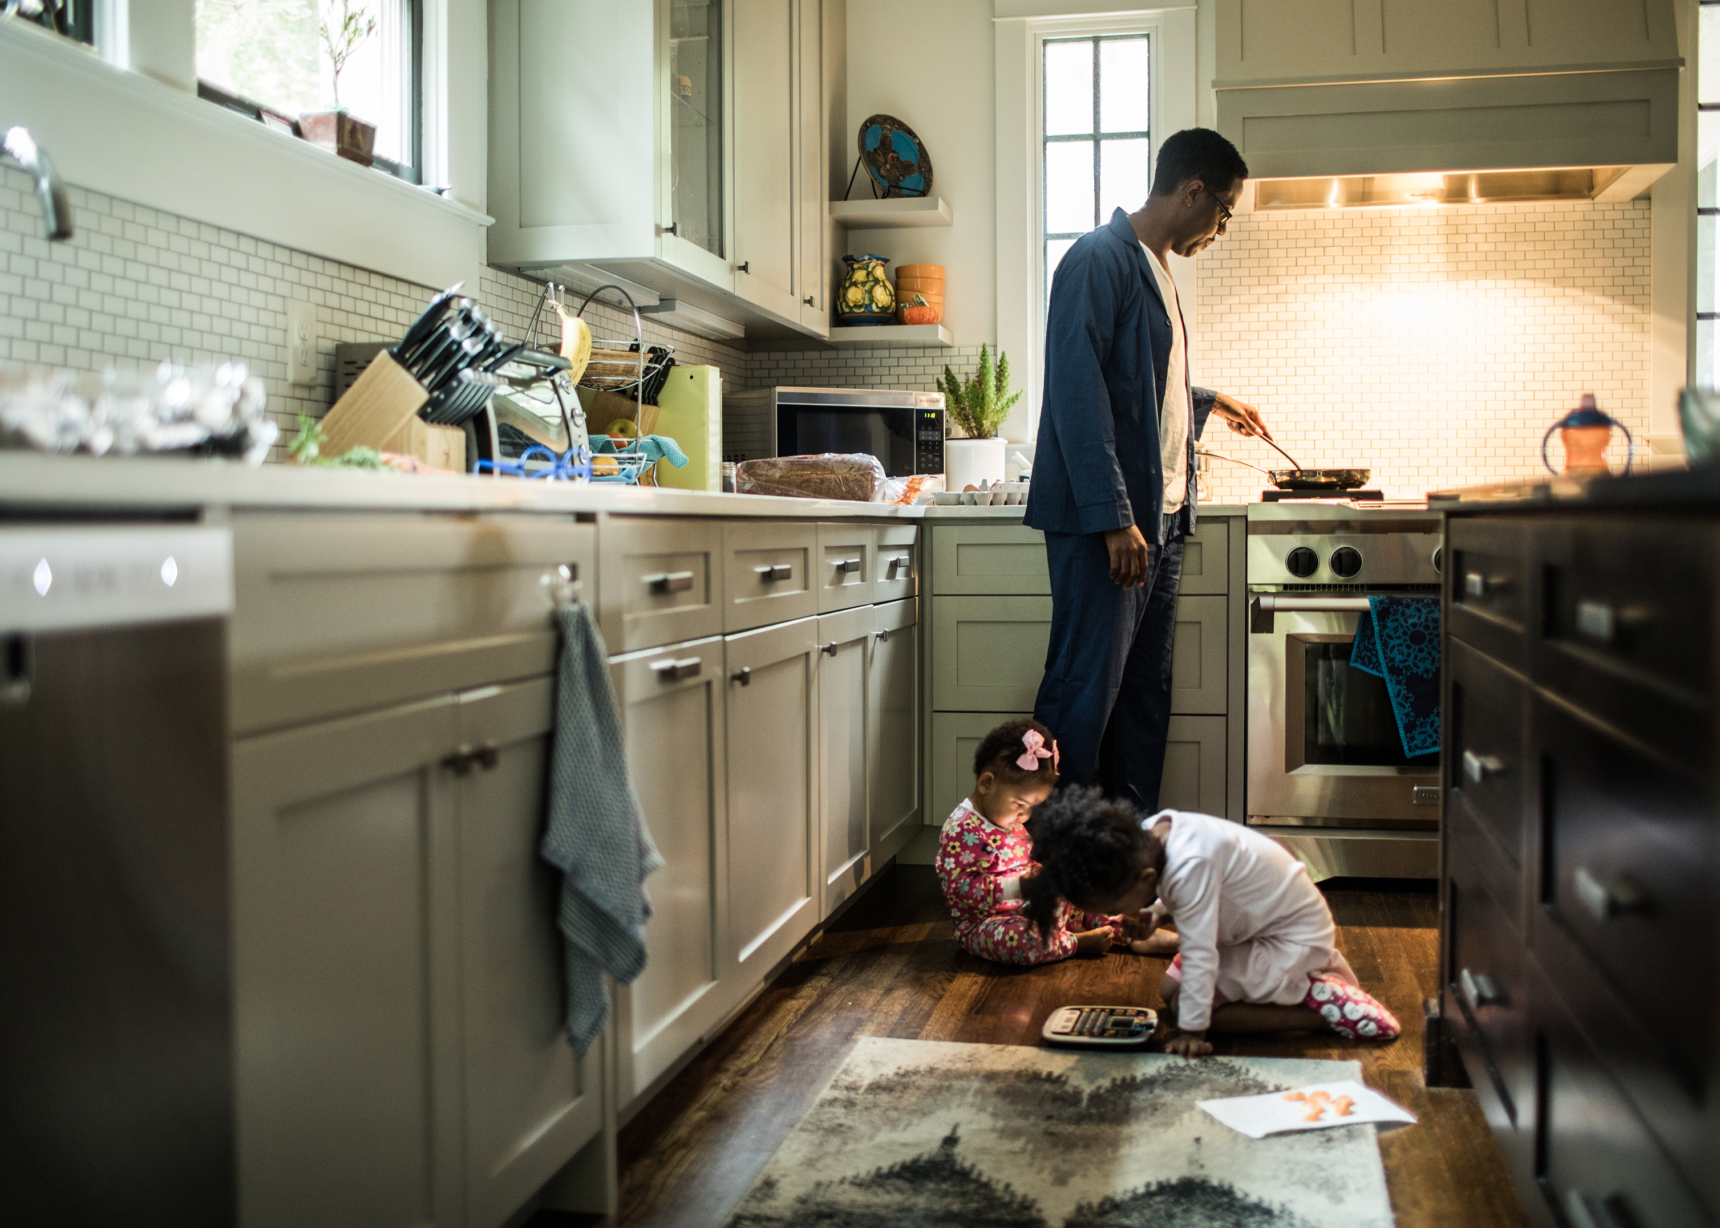
A note from your school:
Our Community has been through a significantly difficult time lately and we are all looking forward to a chance to rest and be with our families.
Often when a community has been through a natural disaster or when our families experience difficulty, we may require the support of community services to ensure the safety and wellbeing of ourselves, our children and young people.
During the Christmas/New Year school holiday period there are services within our Goulburn community that can provide you with supports if and when they are needed.
Our Goulburn child, adolescent and adult mental health services understand that this has been a difficult end of year for most of our families and are expecting that families may engage with them to seek supports for their mental health and wellbeing.
The following information is to support your access to these services should you require them.
IF IT IS AN EMERGENCY ALWAYS CALL 000
Go well this school holiday period and we look forward to seeing you in Term One, 2023.

Slide 3
Helpful Local Council Links for things to do these School Holidays:
Service | What the service can provide | Links
Greater Shepparton Council | Greater Shepparton have a range of programs and support services available, including their youth services FReeZA program. | Greater Shepparton City Council FReeZA - The Music, Arts and Culture Committee | Shaping Greater Shepp (greatershepparton.com.au) Visit Shepparton and Surrounds - Discover Many Great Things
Strathbogie Council | Strathbogie council has a range of FREE things to do check out the links provided | Strathbogie Shire | Council Meetings & Minutes Youth | Strathbogie Shire Whats On | Strathbogie Shire Parks and Playground | Strathbogie Shire

Slide 4
Helpful Local Council Links for things to do these School Holidays:
Service | What the service can provide | Links
Mitchell Shire Council | Mitchell Shire have a range of programs and support services available, including youth services and FREE access to outdoor swimming pools over the summer period. Note: Seymour outdoor swimming pool is currently closed due to damage from recent flooding. | Mitchell Shire Council | Mitchell Shire Council Christmas and New Year events in Mitchell Shire | Mitchell Shire Council Leisure and aquatic centres | Sport and recreation | Mitchell Shire Council Youth services | Services | Mitchell Shire Council
Murrindindi Council | Murrindindi Shire have a range of programs and support services available, including FREE access to shire operated public swimming pools. | Murrindindi Shire Council DindiLink Social Supports Murrindindi Youth Services Murrindindi Shire Youth | Alexandra VIC | Facebook Swimming Pools - Murrindindi Shire Council

Slide 5
Helpful Resources for Health and Wellbeing Supports
Service | What the service can provide | Contact/ Website Seymour | Shepparton
The Bridge Youth Services | TBYS will provide housing, life and parenting skills for young parents to settle into their homes to establish a good rental history and importantly build a safe and secure home for their children. TBYS also provides youth programs that foster connection and skill building. | Phone (03) 5799 1298 Address 119 Wellington St, Wallan | Phone (03) 5831 2390 Email shepparton@thebridge.org.au Address 127 Welsford St, Shepparton
Headspace and eHeadspace | Headspace and eHeadspace provides free online and telephone support & counselling to young people 12-25. If you’re based in Australia and going through a tough time, eheadspace can help. eHeadsapce has online, 1-1 chat and group chat – all moderated by a clinician. Follow on Facebook for more information: headspace Shepparton headspace Craigieburn | Phone (03) 8338 0919 Email info-headspacecraigieburn@orygen.org.au Address Suite 1, Level 1, Central Suites, Craigieburn Central, 340 Craigieburn Road, Craigieburn, Victoria 3064 eheadspace | Our Mental Health Directory | eMHPrac | Phone number (03) 5823 8800 Email headspace@gvhealth.org.au Address 129 High Street, Shepparton, Victoria 3630 eheadspace | Our Mental Health Directory | eMHPrac

Slide 6

Helpful Services for Culturally and Linguistically Diverse Communities
Service | What the service can provide | Links
Primary Care connect | Programs that work specifically with multicultural youth | Refugee Support (primarycareconnect.com.au)
Uniting care | Programs that work specifically with multicultural youth | Diversity Project | Uniting Vic.Tas (unitingvictas.org.au)
Ethnic Council of Shepparton and District | This service provides a range of programs and supports to people in the Shepparton district area and beyond | Ethnic Council of Shepparton and District – serving the settlement communities of the Goulburn Valley (ethniccouncilshepparton.com.au)
Mitchell Multicultural Community Association | This service provides a range of programs and supports to people in the Mitchell Shire area and beyond | MMCAI - Mitchell Multicultural Community Association Incorporated | Facebook Email mitchell.mca.inc@gmail.com

Slide 7


Helpful Resources for ATSI Health and Wellbeing Supports
Service | What the service can provide | Contact/ Website Seymour | Shepparton
13 Yarn Children, young people and adults | If you, or someone you know, are feeling worried or no good, we encourage you to connect with 13YARN on 13 92 76 (24 hours/7 days) and talk with an Aboriginal or Torres Strait Islander Crisis Supporter. This is your story; your journey and we will take the time to listen. No shame, no judgement, safe place to yarn. We’re here for you. | To speak to a 13YARN Crisis Supporter, call 13 92 76 24hrs, 7 days a week | To speak to a 13YARN Crisis Supporter, call 13 92 76 24hrs, 7 days a week
Take A Step Headspace and eHeadspace | Resources and supports for young Aboriginal and Torres Strait Islander peoples: Take a step towards a stronger you: | Take a Step | headspace Provides links to immediate supports and emergency assistance. | Take a Step | headspace Provides links to immediate supports and emergency assistance.

Slide 8
Service | What the service can provide | Contact/ Website Seymour | Shepparton
Orange Door Goulburn | Services offered at Orange Door Goulburn include: Adults, children and young people’s family violence services Child and Family Services Aboriginal Services Services for people who use violence | Phone number 1800 634 245 Email goulburn@orangedoor.vic.gov.au 42/80 Bentinck Street Wallan, 3756 Opening hours 9am to 5pm Monday to Friday (closed public holidays) | Phone number 1800 634 245 Email goulburn@orangedoor.vic.gov.au Entry via Vaughan Street carpark (opposite Kmart/Coles in Vaughan Central) 210 Corio Street Shepparton, 3630
Family Care | Family Care offers a range of services to families and young people in Shepparton, Seymour, Cobram, Kinglake, Wallan, Alexandra, Kilmore and surrounding districts. Supports include: family, carer, disability and NDIS supports | Phone number 03 5735 4600 | Phone number 03 5823 7000
Wellways | Wellways connect people, strengthen families and transform communities for individuals of all ages experiencing disabilities or challenges to their social and emotional wellbeing. | Phone number 1300 111 400 Email enquiries@wellways.org Address Office 5, 54 Tallarook Street, Seymour | Phone number 1300 111 400 Email enquiries@wellways.org Address Room 1, 3A Nixon Street, Shepparton VIC 3630

Slide 9
Service | What the service can provide | Contact/ Website
Partners in Wellbeing | The Partners in Wellbeing service can provide free wellbeing support over the phone and can also discuss options in the local area for face-to-face supports such as local Mental Health and Wellbeing Hubs. | You can contact Partners in Wellbeing via: Phone: 1300 375 330 (9am-10pm weekdays and 9am-5pm weekends) Online: Partners in Wellbeing <https://www.partnersinwellbeing.org.au/>
Mental Health & Wellbeing Hubs | Mental Health and Wellbeing Hubs are free and available to help anyone who is feeling overwhelmed or needs support with mental health concerns. Appointments can be made by calling 1300 375 330 (9am-10pm weekdays and 9am-5pm weekends) and some Hubs are available for walk ins. Services are free and for all ages. | You can contact Mental Health and Wellbeing Hubs via: Phone: 1300 375 330 (9am-10pm weekdays and 9am-5pm weekends) Online: Mental Health and Wellbeing Hubs <https://www.betterhealth.vic.gov.au/mental-health-and-wellbeing-hubs>
Head to Health | Head to Health is a Commonwealth funded service delivered by the Murray Primary Health Network. These services are based in Wodonga, Mildura, Shepparton, Seymour and Bendigo. They provide free mental health support to people living in these towns and by outreach to surrounding communities. | You can contact Head to Health via: Phone: 1800 595 212 (8.30am-5pm weekdays) Online: Murray PHN Head to Health <https://www.murrayphn.org.au/headtohealth/>

Slide 10
Helpful Resource for Emergency/Critical Mental Health Incidents
Service | What the service can provide | Contact/ Website Seymour | Shepparton
Goulburn Valley Health Child and Adolescent Mental Health Service | Child and Youth Mental Health Services The Child and Youth Mental Health Service provide specialist mental health services to infants, children, youth, and their families/carers including: Early life mental health services (0-5 years) Child and Adolescent Mental Health Services (5-18 years) Homelessness Youth Dual Diagnosis (12-21 years) Early Psychosis Services (12-25 years) | Location: Seymour Ph: (03) 5735 0333 Address: Beta Street, Seymour VIC 3660 Hours: 8:30-5:00pm Monday – Friday For more information: Child and Youth Mental Health Service brochure For further information please visit the Hume Region Early Psychosis (HumeREPS)website | Location: Shepparton Ph: (03) 5832 3170 Address: Graham Street, Shepparton VIC 3630 Hours: 8:30-5:00pm Monday – Friday
Goulburn Valley Health Adults | Adult Mental Health Services This service is provided to people aged between 16-64 years of age. The inpatient service is located on the GV Health Campus in Shepparton. | Emergency Department Open 24 Hours (03) 5832 2322 | Emergency Department Open 24 Hours (03) 5832 2322

