Slide 1
VCE Chemistry

Slide 2
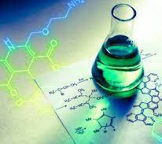
Chemistry – All about matter?
What is matter?
How does matter behave in the natural world?
How does matter interact in the natural world?
How can we shape the atomic level to benefit human health and environment?

Slide 3
Course Overview
Unit 1 – How can the diversity of materials be explained?
Periodic table and trends, types of chemical bonding, the mole concept, polymers and research investigation
Unit 2 – How do chemical reactions shape the natural world?
Acids and bases, redox reactions, water analysis for gases and salts, and practical investigation
Unit 3 – How can design and innovation help to optimize chemical processes?
Fuels, galvanic cells, fuel cells, electrolysis, rate and chemical equilibrium for industrial chemistry.
Unit 4 – How are carbon-based compounds designed for purpose?
Organic Compounds and reactions, analysis of organic compounds, medicinal chemistry + practical investigation

Slide 4
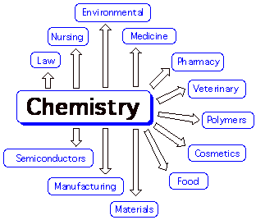
Pathways
Environmental technology and green chemistry
Research and academia
Health and Veterinary Sciences
Education (Chemistry)
Engineering and manufacture
Transport and aviation
Food Technology
Pharmaceutical and Cosmetics
Forensic Science
Waste management and circular economy
Materials (metals, polymers)

Slide 5
What to expect
Chemistry is challenging and rewarding.
To succeed in this subject you will need to:
Work hard and be organised for learning.
Be confident with level 9 mathematics.
Complete significant and regular amounts of study in addition to class time (about 3 hours per week).
Participate in class discussions & practical activities.
Talk to Ms Gao if you would like more information.

