Slide 1
VCE Art Making and Exhibiting 2023-2027
Study Design overview

Slide 2
Art Making and Exhibiting - Aims
explore the characteristics and properties of materials, techniques and processes
understand the use and application of materials in relation to the historical development of art forms, across different periods of time and cultures
develop an understanding of aesthetic qualities in artworks and how they are used in art making
learn how to work independently and collaboratively
develop an understanding of the sources that inform and influence art making
investigate the practices of artists from different periods of time and cultures, including Aboriginal and Torres Strait Islander artists, and their use of materials, techniques and processes, and how these contribute to the making of their artworks
understand how artists use visual language to communicate ideas and meaning in artworks
understand how exhibitions are planned and produced by galleries, museums, other exhibition spaces and site-specific spaces and how artworks are curated and displayed for audiences
understand the methods used and considerations involved in the preparation, presentation and conservation of artworks.
Notes:
Run through the aims.

Slide 3
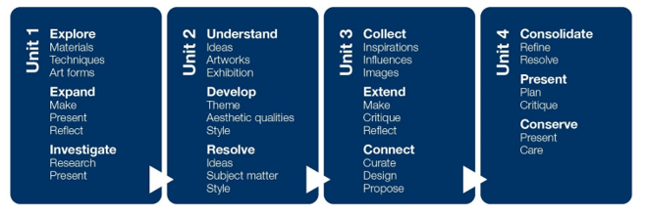
VCE Art Making and Exhibiting Study specifications
Explore
Expand
Investigate
Understand
Develop
Resolve
Collect
Extend
Connect
Consolidate
Present
Conserve
Notes:
Pge 11
Each Area of Study has a focus for Making and Presenting artworks.
Unit 1 AOS 1 Explore – Materials, techniques, Artforms
Unit 1 AOS 2 Expand – Make, Present and Reflect
Unit 1 AOS 3 Investigate – Research and Present
Unit 2 AOS 1 Understand – Artworks, Ideas and Exhibitions
Unit 2 AOS 2 Develop – Theme, Aesthetic qualities, Style
Unit 2 AOS 3 Resolve – Ideas, Subject matter, Style
Unit 3 AOS 1 Collect – Inspiration, influences, images
Unit 3 AOS 2 Extend – Make, Critique, reflect
Unit 3 AOS 3 Connect – Curate, Design, Propose
Unit 4 AOS 1 Consolidate – Refine and resolve
Unit 4 AOS 2 Present – Plan and Critique
Unit 4 AOS 3 Conserve – Present and care

Slide 4
VCE Art Making and Exhibiting Study specifications: Making artworks
Making artworks
Artforms
Techniques
Processes
Materials
Aesthetic qualities
Art elements and Art Principles
Visual Language
Ideas and meaning
Influences and inspiration
Explore
Expand
Investigate
Understand
Develop
Resolve
Collect
Extend
Connect
Consolidate
Present
Conserve
Notes:
Pge 12

Slide 5
VCE Art Making and Exhibiting Study specifications: Exhibiting artworks
Exhibition design
Curation
Conservation
Planning and producing the layout and design of the exhibition and planning the ‘flow’ of the exhibition, including sight lines, spatial relationships, viewer interaction and interpretation. Includes the creation of display furniture, selection of fixtures and use of lighting.
Determining the theme or story to be told in an exhibition. Curation includes the selection of artworks, writing the introduction to the exhibition, deciding where artworks will be placed, the designing of viewer interaction and interpretation, and the preparation of condition reports of artworks.
Planning, organising and undertaking the preservation and conservation of materials and objects in private, public and community collections, including art galleries, museums, other exhibition spaces and site-specific spaces.
Notes:
Pge 13

Slide 6
VCE Art Making and Exhibiting Study specifications: Exhibiting artworks
Exhibition design
Curation
Conservation
Explore
Expand
Investigate
Understand
Develop
Resolve
Collect
Extend
Connect
Consolidate
Present
Conserve
Museums
Galleries
Other exhibition spaces
Site specific spaces
Notes:
Pge 13

Slide 7
VCE Art Making and Exhibiting Study specifications: Study Terms
Common terms
Art elements
Art principles
Art forms
Contexts
Critique
Influences and inspiration
Visual language
Art Making and Exhibiting
Aesthetic qualities
Art Creative Practice
Body of Work
Contemporary artists and artworks
Notes:
Pge 14
Aesthetic qualities are usually explained as the way in which art elements, art principles, materials and techniques work together to influence the mood or emotion of an artwork. The term refers to the visual appeal of an artwork and how aesthetic qualities evoke an emotional impact and reaction within the viewer.
For the purposes of this study the following are accepted explanations of aesthetic qualities:
the visual appearance of an artwork
an emotional impact or reaction the artist intends the viewer to experience
the use of art elements and art principles that allow the artist to convey a certain mood and evoke feelings in the viewer
the materials and techniques used in an artwork to create qualities that speak to the overall feeling, mood or emotion of the artwork.

Slide 8
VCE Art Making and Exhibiting Unit 1: Explore, expand and investigate
Exploration of materials, techniques and processes in a range of art forms
Study of the historical development of specific art forms and the change in characteristics and properties
Exploration of how artists use materials, techniques and processes to stimulate ideas and working practices in a range of art forms
Presentation of artworks and research with a focus on exhibitions
Area of Study | Inquiry focus
Area of Study 1 | Explore - materials, techniques and art forms How do artists use materials and techniques in their art making?
Area of Study 2 | Expand - make, present and reflect How do artists use materials and techniques to represent ideas and achieve a style in their artworks?
Area of Study 3 | Investigate - research and present What role do artworks and their presentation play in society?

Slide 9
VCE Art Making and Exhibiting Unit 1: Explore, expand and investigate
Area of Study | Content summary
Area of Study 1 Explore - materials, techniques and art forms | Explore characteristics and properties of materials Technical skill Materials and techniques to develop visual language and subject matter Documentation of the processes
Area of Study 2 Expand - make, present and reflect | Make and present a finished artwork in a specific art form Subject matter and representation of ideas Visual language in artworks Documentation, presentation and evaluation of artworks
Area of Study 3 Investigate - research and present | Focus on artworks by Australian artists including Aboriginal or Torres Strait Islander artists Research of artists and artworks Presentation of information with an exhibition focus

Slide 10
VCE Art Making and Exhibiting Unit 1 Assessment
Outcome | Assessment Task
Outcome 1 On completion of this unit the student should be able to explore the characteristics and properties of materials and demonstrate how they can be manipulated to develop subject matter and represent ideas in art making. | Visual Journal demonstration of the exploration of materials, techniques and processes, in a range of art forms demonstration of technical skill in using materials in a range of art forms documentation and evaluation of the exploration of materials, techniques and processes in a range of art forms.
Outcome 2 On completion of this unit the student should be able to make and present at least one finished artwork and document their art making in a Visual Arts journal. | Finished artworks One finished artwork in a specific art form developed from the experimental work in Outcome 1

Slide 11
VCE Art Making and Exhibiting Unit 1 Assessment
Outcome 3
On completion of this unit the student should be able to research Australian artists and present information about them in a format appropriate for a proposed exhibition.
Task Information about three Australian artists, including at least one Aboriginal or Torres Strait Islander artist, at least one artwork by each artist one of the following formats a guided introduction to the works in a brochure or catalogue or on a website a guided tour of the exhibition a series of postcards discussing each artwork a review of an exhibition visited or viewed. | Information about three Australian artists, including at least one Aboriginal or Torres Strait Islander artist, at least one artwork by each artist in one of the following formats a guided introduction to the works in a brochure or catalogue or on a website a guided tour of the exhibition a series of postcards discussing each artwork a review of an exhibition visited or viewed.
The presentation includes: an artwork by each artist with the title, date, materials, current location and size information and overview of each artist, including the artist’s background, where they work/worked and influences information and overview of the exhibition of the artworks, discussing the relationships between the artists and their artworks | information about the materials, techniques and processes used for each artwork information about how each artist applies materials, techniques and processes in the artworks information about how each artist represents ideas, develops subject matter and communicates meaning in their artworks art terminology relevant to specific art forms and for the exhibition of artworks.

Slide 12
Art Making and Exhibiting Unit 2: Understand, develop and resolve
Research into art elements and art principles to create aesthetic qualities, style and visual language
Students develop artworks from a set theme
How exhibitions are designed and planned – research of galleries, museums, site-specific spaces and other exhibition spaces.
Area of Study | Inquiry focus
Area of Study 1 | Understand – ideas, artworks and exhibition How are thematic exhibitions planned and designed?
Area of Study 2 | Develop – theme, aesthetic qualities and style How does an artist develop aesthetic qualities and style in artworks?
Area of Study 3 | Resolve – ideas, subject matter and style How does an artist develop ideas and a personal style in artworks?

Slide 13
Art Making and Exhibiting Unit 2: Understand, develop and resolve
Area of Study | Content summary
Area of Study 1 Understand – ideas, artworks and exhibition | Design of a thematic exhibition Information about artists and artworks The influence of context on subject matter and the communication of meaning.
Area of Study 2 Develop – theme, aesthetic qualities and style | Experimental art making Demonstrate aesthetic qualities are created and contribute to style in artworks Demonstrate how art elements, art principles and aesthetic qualities represent subject matter and ideas in artworks
Area of Study 3 Resolve – ideas, subject matter and style | Development of a finished artwork(s) from experimentation Focus on art elements, art principles, aesthetic qualities, style and visual language Resolution of subject matter and ideas

Slide 14
Art Making and Exhibiting Unit 2 Assessment
Outcome 1
On completion of this unit the student should be able to select a range of artworks from an exhibition and other sources to design their own thematic exhibition.
Thematic exhibition Students design and curate a thematic exhibition of six artworks: three artworks selected from a thematic exhibition the student has viewed three artworks selected from images the student has personally sourced
Using the collection of six artworks; discuss the influences of contexts on the subject matter and ideas in the artworks selected for the exhibition justify the selection of artworks from an exhibition based on an identified theme justify the selection of individually sourced artworks based on an identified theme provide a short overview of the exhibition (400–600 words) design an exhibition proposal, considering the presentation of the artworks.
Recommended formats a series of plans and drawings with accompanying written information or annotations a digital tour of the exhibition, including initial designs and written information, such as an online presentation, video or interactive website an annotated presentation with initial visual designs and accompanying written information an oral presentation with supporting written and visual information.

Slide 15
Art Making and Exhibiting Unit 2 Assessment
Outcome | Assessment Task
Outcome 2 On completion of this unit the student should be able to explore and progressively document the use of art elements, art principles and aesthetic qualities to make experimental artworks in response to a selected theme. | Experimental artworks and documentation Students explore aesthetic qualities and the use of materials, techniques and processes in artworks. Produce a series of experimental artworks based on subject matter and ideas in response to a selected theme
Outcome 3 On completion of this unit the student should be able to progressively document art making to develop and resolve subject matter and ideas in at least one finished artwork. | Finished artworks Students present at least one finished artwork, with accompanying documentation of the development and refinement of art making, in their Visual Arts journal. The artwork(s) is developed from the experimental works made in Area of Study 2.

Slide 16
Art Making and Exhibiting Unit 3: Collect, extend and connect
Art making in a selected art form using materials, techniques and processes based on an exploration of contexts, subject matter, ideas and visual language
Documentation of art making in the visual diary
Presentation of a critique of art making and art works
Research into the planning and presentation of an exhibition including the role of a curator.
Area of Study | Inquiry focus
Area of Study 1 | Collect – inspiration, influences and images How do artists use selected art forms and ideas to create visual language?
Area of Study 2 | Extend – make, critique and reflect How are ideas, reflection and feedback used in art making to develop artworks?
Area of Study 3 | Connect – curate, design and propose How are artworks selected and presented for exhibition?

Slide 17
Art Making and Exhibiting Unit 3:Collect, extend and connect
Area of Study | Content summary | Assessment
Area of Study 1 Collect – inspiration, influences and images | Research into the inherent characteristics of a specific art form – 3 artists as inspiration Collection of ideas to inform the experimentation and exploration of subject matter, ideas and technical skill Experimentation of materials, techniques and processes How artists represent ideas and communicate meaning in subject matter | School-assessed Task
Area of Study 2 Extend – make, critique and reflect | Make artworks in specific art forms based on influences, exploration and reflection Develop visual language to communicate meaning Documentation of art making Prepare and present a critique
Area of Study 3 Connect – curate, design and propose | Investigation of how curators plan exhibitions, prepare and display art works Plan and develop an exhibition proposal for a specific space based on Area of Study 1 Explain the thematic connections in an exhibition the student has prepared Present and discuss didactic information for an exhibition of artworks | School-assessed Coursework

Slide 18
Art Making and Exhibiting Unit 4: Consolidate, present and conserve
Consolidation and extension of ideas from Unit 3 in art making
Use of the Unit 3 critique to broaden ideas and art making
Resolution and refinement
Presentation of finished artworks from art making
Research into the presentation, conservation and care of artworks
Area of Study | Inquiry focus
Area of Study 1 | Consolidate – refine and resolve How do artists refine and resolve artworks?
Area of Study 2 | Present – plan and critique How are ideas presented in finished artworks on exhibition?
Area of Study 3 | Conserve – present and care What role does conservation and care have in the presentation of artworks?

Slide 19
Art Making and Exhibiting Unit 4:Consolidate, present and conserve
Area of Study | Content Summary | Assessment
Area of Study 1 Consolidate – refine and resolve | Refine and resolve at least one finished artwork in a specific art form Document and record art making Extend and resolve ideas from Unit 3 Extend and refine the use of materials, techniques and processes from Unit 3 | School-assessed Task
Area of Study 2 Present – plan and critique | Research and discuss the display of artworks in specific exhibition spaces Plan and document the display of one artwork in a specific space Present and evaluate the artwork in a critique Evaluate ideas, subject matter, materials, techniques and processes
Area of Study 3 Conserve – present and care | Methods used and considerations in the presentation, conservation and care of artworks Discuss the relevant conservation and care methods to artworks on display, handling, storage and transportation; including their own artworks. | School-assessed Coursework

Slide 20
Art Making and Exhibiting Unit 3 and 4 Assessment Weightings
Areas of Study | Assessment Type | Weighting
Unit 3 Outcome 1 Unit 3 Outcome 2 Unit 4 Outcome 1 Unit 4 Outcome 2 | School-assessed Task | 60 percent
Unit 3 Outcome 3 Unit 4 Outcome 3 | School-assessed Coursework | 10 percent
End-of-year examination | External assessment | 30 percent

Slide 21
Art Making and Exhibiting Unit 3 School-assessed Task

Slide 22
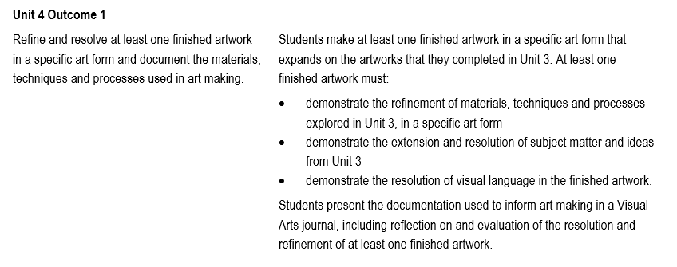
Art Making and Exhibiting Unit 4 School-assessed Task

Slide 23
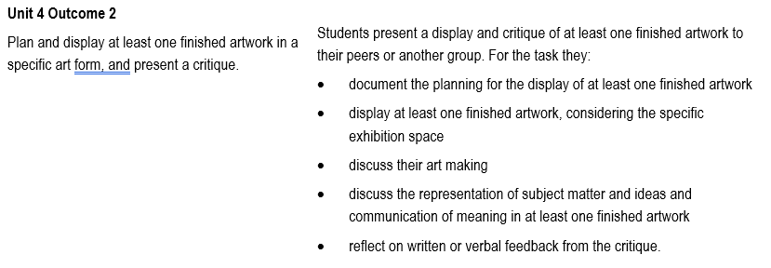
Art Making and Exhibiting Unit 4 School-assessed Task

Slide 24
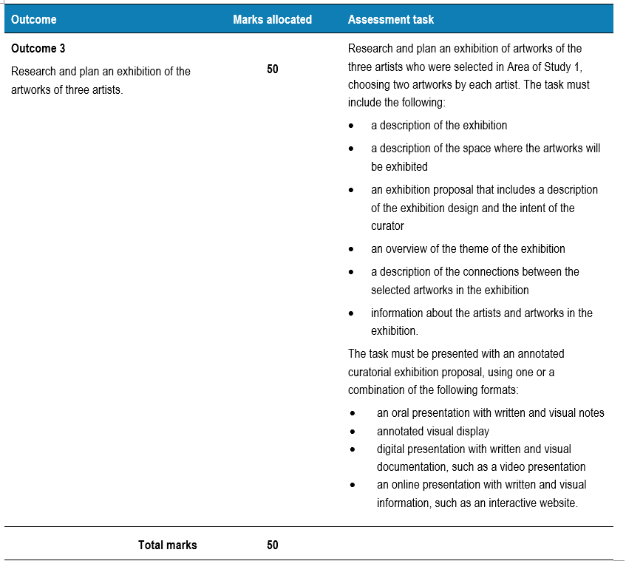
Art Making and Exhibiting Unit 3 School-assessed Coursework

Slide 25
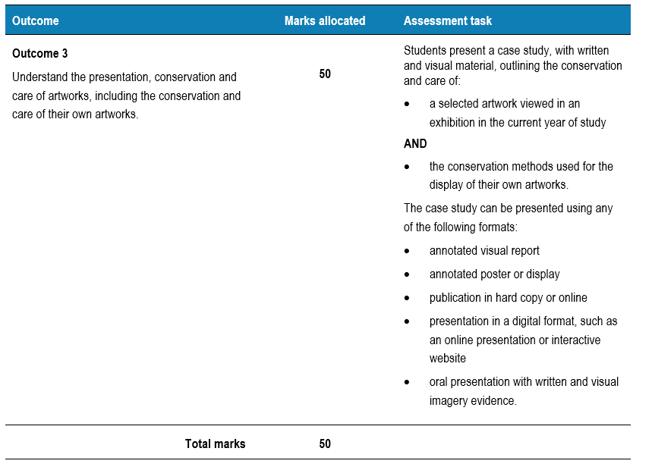
Art Making and Exhibiting Unit 4 School-assessed Coursework

