Slide 1
VCE Physics

Slide 2
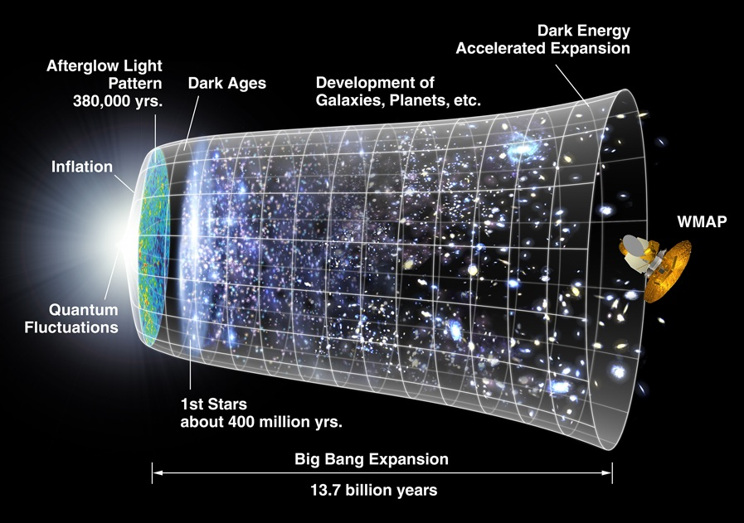
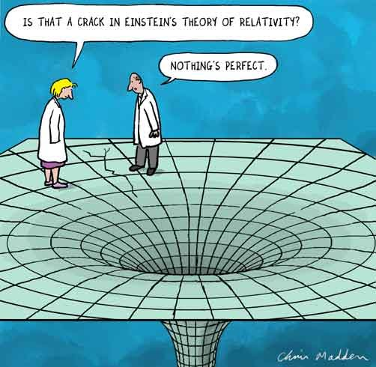
Physics involves investigating, understanding and explaining the behaviour of physical phenomena in the Universe
VCE Physics enables students to use observations, experiments, measurements to develop qualitative and quantitative explanations for phenomena.
They explore the big ideas that changed the course of thinking in physics such as relativity and quantum physics

Slide 3
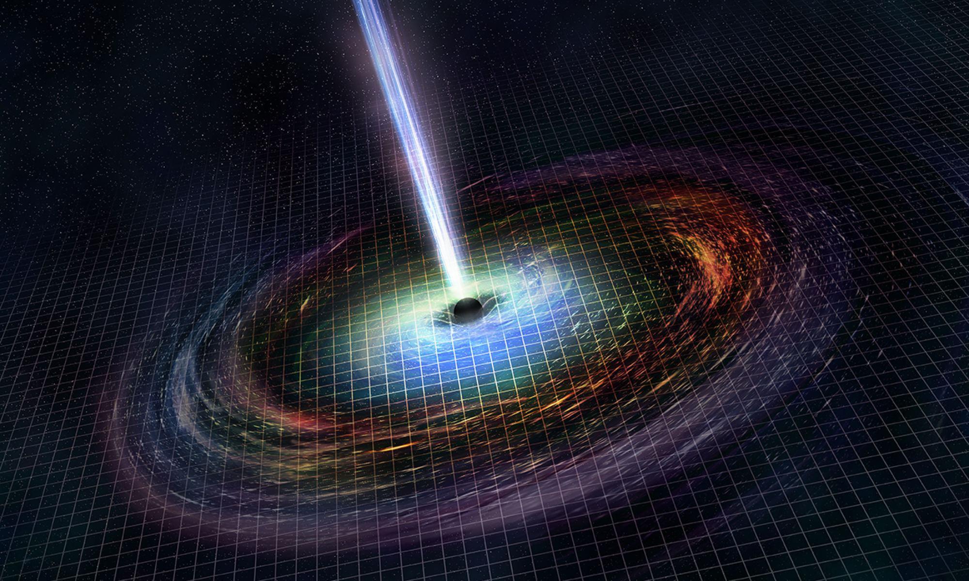
Course Overview
Unit 1: How is energy useful to society
Students endeavor to understand light, thermal energy, radioactivity, nuclear processes and electricity.research investigation
Unit 2: How does physics help us to understand the world?
Students investigate the ways in which forces are involved both in moving objects and in keeping objects stationary and apply these concepts to a chosen case study of motion. practical investigation
Unit 3: How do fields explain motion and electricity?
Students compare and contrast three fundamental fields – gravitational, magnetic and electric – and how they relate to one another.
Unit 4: How have creative ideas and investigation revolutionised thinking in physics?
students explore some monumental changes in thinking in Physics that have changed the course of how physicists understand and investigate the Universe.

Slide 4
Pathways

Slide 5
What to expect
Physics is challenging and rewarding.
To succeed in this subject you will need to:
Work hard and be organised for learning.
Be confident with level 10 mathematics.
Complete significant and regular amounts of study in addition to class time (about 3 hours per week).
Participate in class discussions & practical activities.
Talk to Ms Dodds if you would like more information.

