Slide 1
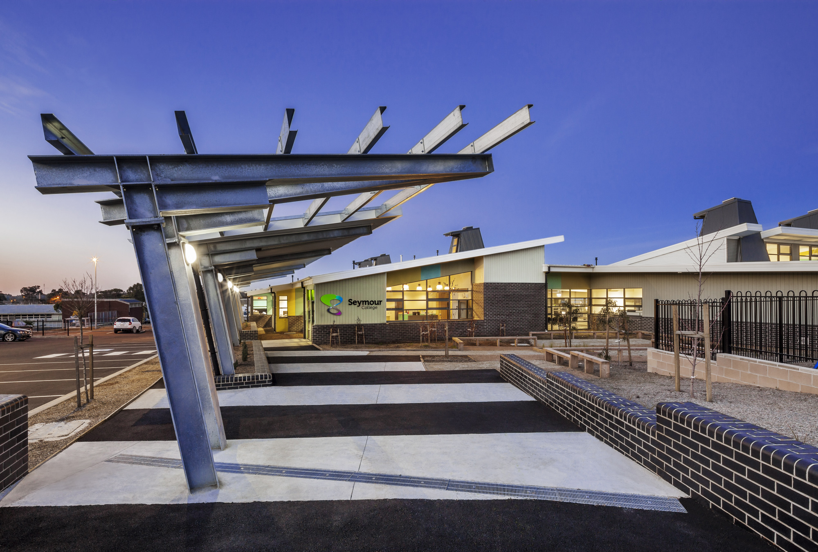
Seymour College: VCE VM Information Session 2023
The VCE VM overview will be provided by Lisa Macheras and Leanne Hayek
Respect – Inspire - Excel

Slide 2
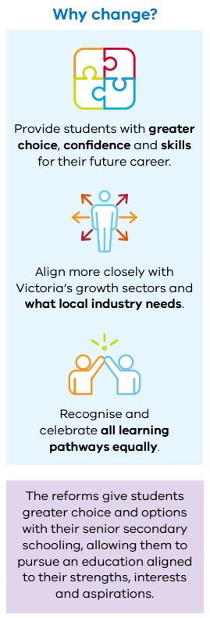
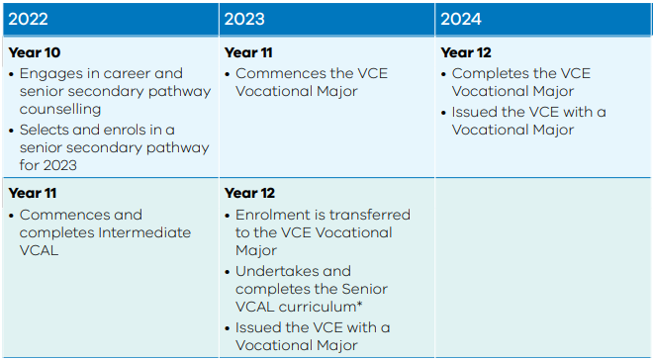
Introduction to the new VCE VM
https://www.vcaa.vic.edu.au/victorianseniorsecondarycertificatereform/Pages/Index.aspx?fbclid=IwAR3tG8pwqJNoZJJOX8D7yK0s0YgLGjI7Ogf-uyhWDoqZH47suux_3sA7d58#pathwayvideos

Slide 3
Should I choose VM (Vocational Major)?
VM is
VM is NOT
A valuable option for students seeking a high-quality vocational pathway
For motivated students
An engaging approach to delivering curriculum which connects to learners' interests and promotes success through authentic assessments
Connecting theory to application, providing real life learning experiences in and outside the classroom
The development of employability skills
Giving students more independence with their learning
Students who are willing to do VET and work placement which are both compulsory.
The easy option
Always for disengaged students
Always ‘hands on’ or kinesthetic
Meeting the immediate entry requirements for many University courses, and does not provide an ATAR ranking
For people who do not want to do work outside the classroom with the community.
For students who are not committed. Students in VM must successfully pass each subject in order to achieve their VM
For students who don’t like leaving the school – we go on a number of excursions that are compulsory.

Slide 4
VM Structure
Year 11 and 12 Seymour VM students will attend Seymour College 3 days in 2024 and will complete the 4 core VM subjects.
1 day at their external VET
1 day at SWL
On a case by case basis, student may have the opportunity to do 1 VCE subject.

Slide 5
VCE Vocational Major
The VCE Vocational Major Curriculum
VCE Vocational Major is a pathway to completing your senior education with a focus on trades and TAFE pathways. It includes an applied learning pedagogy.
Five areas of study (all of which are compulsory):
1. Literacy/English
2. Numeracy/Mathematics
3. Work Related Skills
4. Personal Development
5. VET
Students within this major will also complete Structured Workplace Learning
Notes:
One of the main benefits of the VCE Vocational Major is its emphasis on practical work-related skills, with two of the four strands focusing on providing practical work and industry experience. Students are able to focus on a specific industry by completing a VET qualification.
It provides students with the opportunity to develop ‘employability skills’ which can be used as a pathway into
further training at TAFE Colleges, other training providers
Industry related training via Apprenticeships / Traineeships
Employment linked to training
Opportunities to build personal skills and work related skills that are important for life and work
Our VCE Vocational Major does not meet the immediate entry requirements for University and does not provide an ATAR ranking

Slide 6
VCE VM - Subjects
VCE VM Rules | Options at Seymour College for Year 11 2023
3 Literacy (or VCE English) units (including a Unit 3 and 4 sequence) | Seymour VM students will complete VM Literacy
Two Numeracy (or VCE Maths units) | Seymour VM students will complete unscored VCE Foundation Maths
Two Work Related Skills units | Seymour VM students will complete VM Work Related Skills
Two Personal Development Skills Units | Seymour VM students will complete VM Personal Development Skills
180 nominal hours of VET at Cert II level or above | Seymour VM students will complete their external VET course.

Slide 7
Literacy
Focus on read, write, speak and listen in different contexts for daily life in the 21st Century.
Strong connections between students’ lives and their learning.
Unit 1:
Area of Study 1: Literacy for personal use
Area of Study 2: Understanding and creating digital texts
Unit 2:
Area of Study 1: Understanding issues and voices
Area of Study 2: Responding to opinions
Unit 3:
Area of Study 1: Accessing and understanding informational, organisational and procedural texts.
Area of Study 2: Creating and responding to organisational, informational or procedural text
Unit 4:
Area of Study 1: Understanding and engaging with literacy for advocacy
Area of Study 2: Speaking to advise or to advocate

Slide 8
PDS (Personal Development Skills)
Focuses on helping students develop personal identity and individual pathways to optimal health and wellbeing.
Students participate in an extended project relating to a community issue. Students will identify environmental, cultural, economic and social issues affecting the community and select one for an extended community project. Students will reflect on how community awareness of their selected issue can be improved.
Unit 1: Healthy individuals
Area of Study 1: Personal identity and emotional intelligence
Area of Study 2: Community health and wellbeing
Area of Study 3: Promoting a healthy life
Unit 2: Connecting with community
Area of Study 1: What is community?
Area of Study 2: Community cohesion
Area of Study 3: Engaging and supporting community
Unit 3: Leadership and teamwork
Area of Study 1: Social awareness and interpersonal skills
Area of Study 2: Effective leadership
Area of Study 3: Effective teamwork
Unit 4: Community project
Area of Study 1: Planning a community project
Area of Study 2: Implementing a community project
Area of Study 3: Evaluating a community project

Slide 9
WRS (Work Related Skills)
VCE VM Work Related Skills allows students to understand and apply concepts and terminology related to the workplace and further studies to understand the complex and rapidly changing world of work and workplace environments.
It helps students understand and develop their skills, knowledge, capabilities and attributes as they relate to further education and employment, to develop effective communication skills to enable self-reflection and self-promotion and to practically apply their skills and knowledge.
Unit 1: Careers and learning for the future
Area of Study 1: Future careers
Area of Study 2: Presentation of career and education goals
Unit 2: Workplace skills and capabilities
Area of Study 1: Skills and capabilities for employment and further education
Area of Study 2: Transferable skills and capabilities
Unit 3: Industrial relations, workplace environment and practice
Area of Study 1: Workplace wellbeing and personal accountability
Area of Study 2: Workplace responsibilities and rights
Area of Study 3: Communication and collaboration
Unit 4: Portfolio preparation and presentation
Area of Study 1: Portfolio development
Area of Study 2: Portfolio presentation

